Slide 1
Weekcode
Tree Month
Week 8: The Tree Vocabulary Exercise, Tree Properties Exercise, and Tree Memory Exercise

Slide 2

April is Tree Month
Every Weekcode in April will be related to Trees
This week will cover Tree fundamentals
Following weeks will cover various Tree data structures

Slide 3
Real-World Tree Applications
Windows, Unix, and macOS use Trees to organize their hierarchical file systems
Compilers rely upon ASTs (Abstract Syntax Trees) to translate syntactically correct code
Compression of files uses entropy coding techniques to identify redundant data, which is built upon Huffman Trees (.jpeg, .zip, .mpeg, ect)
Decision Trees are used in machine learning to predict output based on input, which aids in the regression process

Slide 4
Real-World Tree Applications [More]
Spanning Trees are used in IT networking topologies to ensure efficient broadcasting of data packets and to prevent Bridge Loops
XML/HTML files are parsed as DOM (Document Object Model) Trees (Javascript frontend frameworks manipulate virtual DOMs)
B-Trees are often used in large relational databases for various queries
Game designers use Trees to swap objects in accordance to their LOD (Level of Detail) in a scene relative to rendering distance from camera

Slide 5
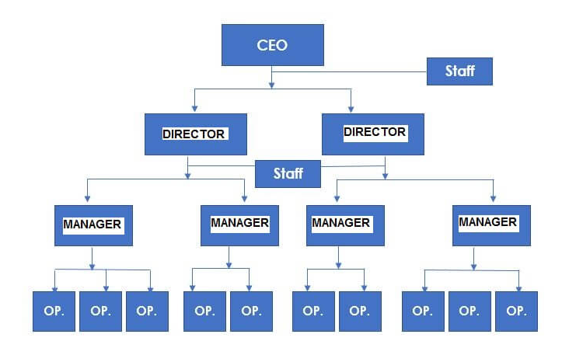

Introduction to Trees
Trees are a type of graph
Trees come in several varities
Primary components of a Tree:
Hierarchical
Non-Linear
Relationships

Slide 6
Relationships within a Tree
Node: Individual item on a Tree
Edge: Relational links between Nodes
Parent: A Node that derives other Nodes
Child: A Node derived from a Node
Sibling: Children derived of the same Parents
Leaf: A Child with no Children of its own
Ancestor: A Parent with “Grandchildren”
Descendant: A “Grandchild” of an Ancestor
Root: The Ancestor of all Nodes on the Tree
Subtree: A Tree within a Tree

Slide 7
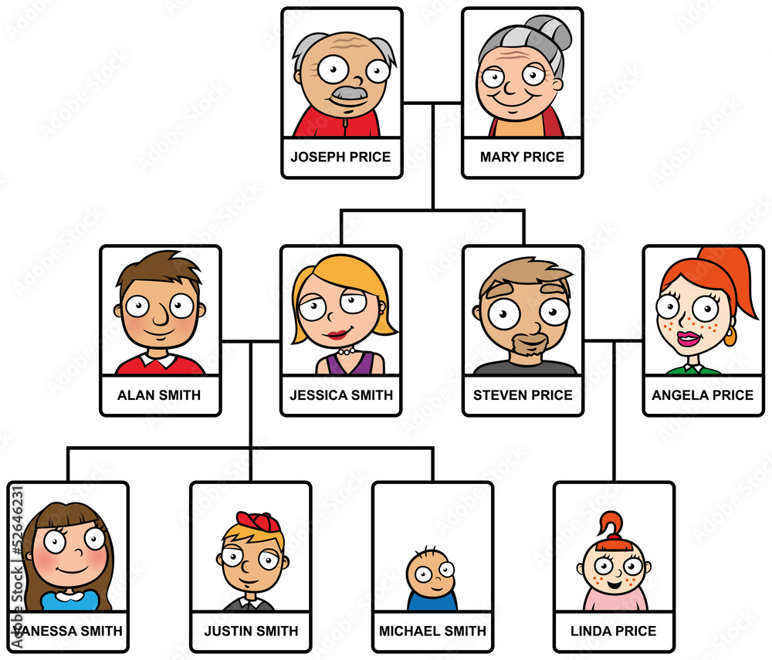

Slide 8
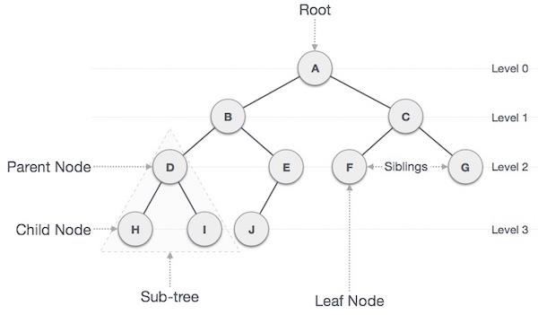

Slide 9
The Many Forms of Trees
Trees can take can be organized into various forms:
Binary Tree
Heap
Max Heap
Min Heap
Binary Search Tree
Splay Tree
AVL Tree
Red-Black Tree
Trie
B-Tree

Slide 10
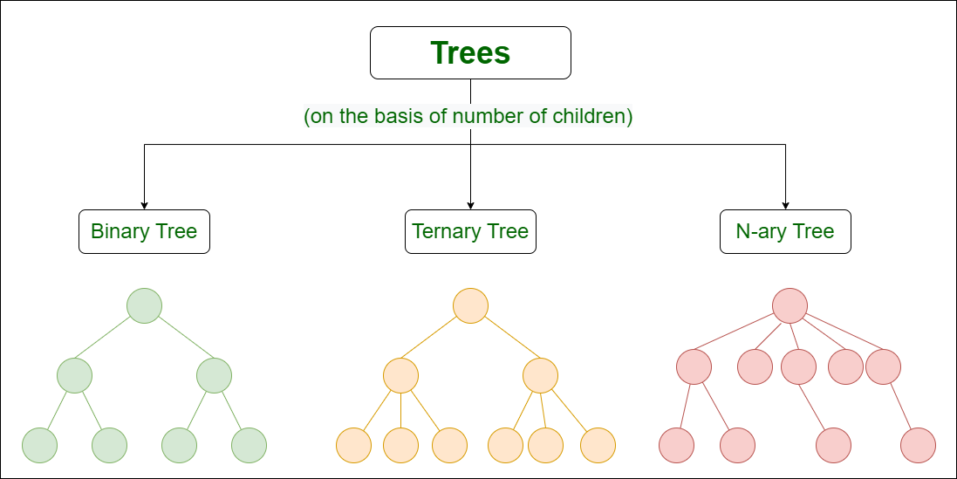

Slide 11
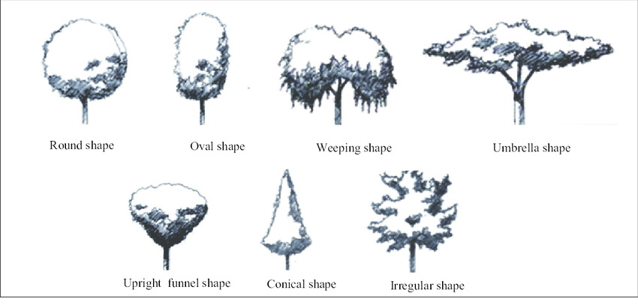
Introduction to Tree Validity
Shape: The organization of Nodes and Edges of a Tree
The Shape of a Tree can change from Tree type to Tree type, and each Tree type will have some unique rules for Shape validity
There are some rules of validity that are true for all Trees, however

Slide 12
Rules of Tree Validity:
1) All Trees have only 1 Root, and the Root never has Parents
2) All Children have exactly 1 Parent, and all Children have 0-X amount of their own Children
3) All Nodes have at least 1 Edge (The Root only has outgoing Edges, Leaves only have incoming Edges, and all other Nodes have only 1 incoming Edge and X outgoing Edges
4) All Nodes only connect to the layer immediately above or below them
5) All Trees are acyclical

Slide 13
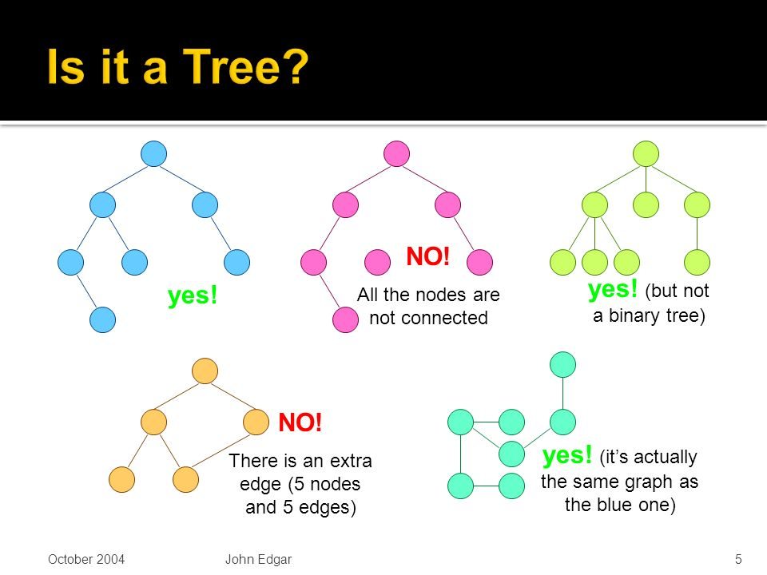
Are these Trees valid?

Slide 14
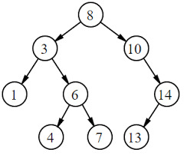
Edges of a Tree
In a valid Tree, every inner Node will have 1 incoming Edge, and X outgoing Edges
The Root will never have incoming Edges
For any valid Tree of N Nodes, there will be ____ Edges
N-1 Edges for any valid Tree of N Nodes

Slide 15
Depth, Height, and Level of Trees
All Trees have Depth, Height, and Levels
Depth: The distance from some Node N from its Root R
Height: The distance between some Node N and the furthest Leaf that exists in N’s subtree
Level: Refers to the generational distance a group of Nodes have to some other group of Nodes
The Depth of all Roots is 0, and the Height of all Leaves is 0
In a valid Tree, maximum Height will always equal maximum Depth

Slide 16
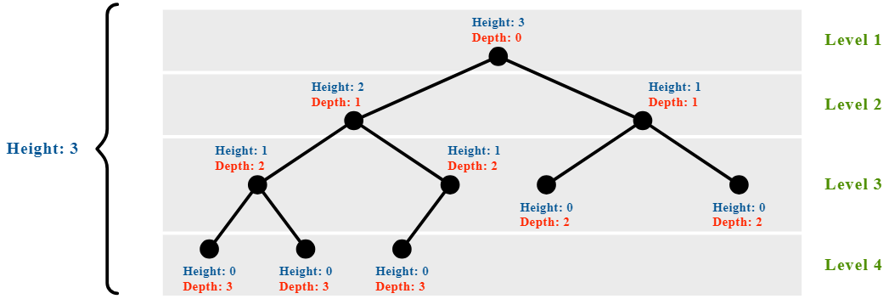
Leaves of the same Level will always have identical Depths and Heights to each other

Slide 17
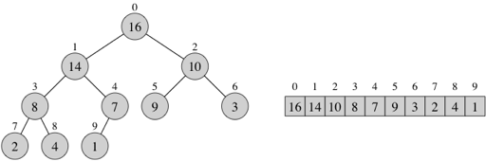
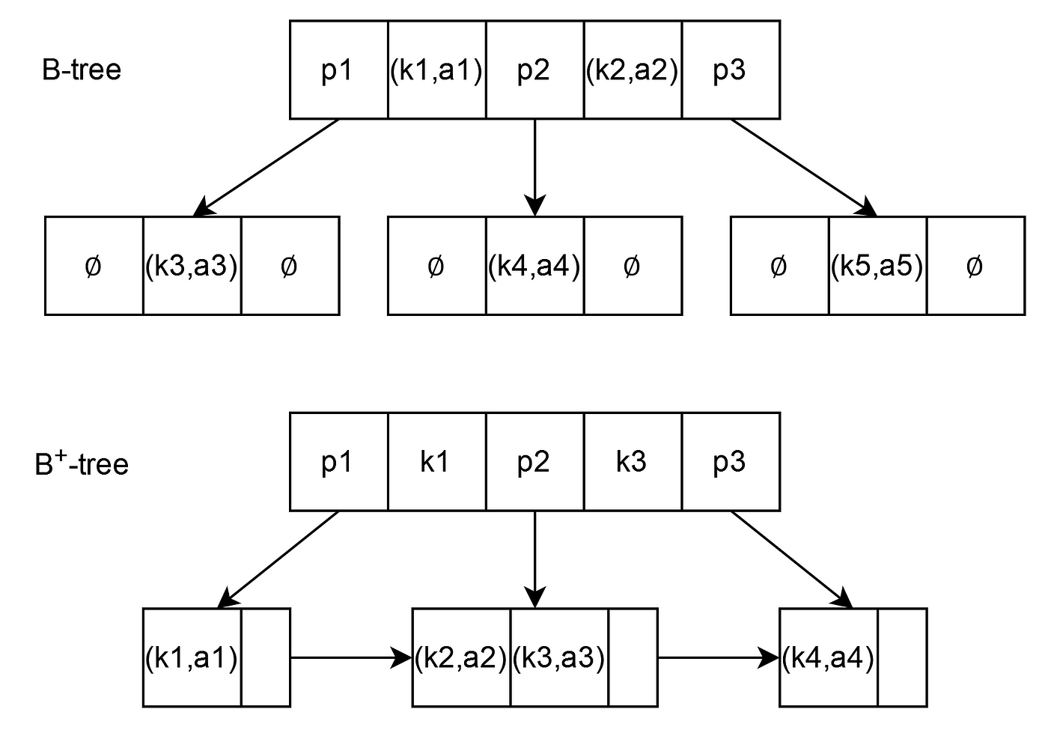
How are Trees stored in Memory?
Two primary methods of storing Nodes in memory:
Array-Based Indexing (Common for Binary Trees)
Pointer-Based Indexing (Common for B-Trees)

Slide 18
Array-Indexed Trees [Breadth-First]
Only works for Tree with fixed branching degrees (binary = 2, ternary = 3, quaternary = 4, ect)
Root is established at index 0
All Nodes are inserted from left to right respective to the Level of the Tree
The index of any Child in an array can be expressed as: Ai + B (A = degree of branching, i = index of Parent, B = offset from i)
ex): In a Binary Tree, a Parent’s Child can be found 2i + 0 or 2i + 1 indexes from its Parent (0 = left Child, 1 = right Child.

Slide 19
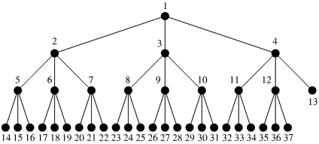
If this Tree were stored in an array, index 0 would be 1, and index 36 (the last index) would be 37 (Hence, “Breadth-First”)

Slide 20
Pointer-Indexed Trees [Depth-First]
Similar to a Doubly Linked List (and thus stored in memory in basically the same way)
Each Node must have at least three fields:
Left Pointer
Data
Right Pointer
Three major methods of Pointer-Tree Traversal (all are recursive):
Preorder Traversal: Begin at the Root, iterate through the left subtree, and then the right subtree
Inorder Traversal: Begin in the left subtree, iterate until you reach the Root, then iterate over the right subtree
Postorder Traversal: Begin in the left subtree, then the right subtree, and finish at the Root

Slide 21
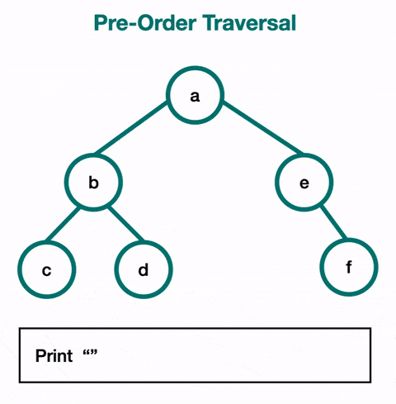
<root><left><right>

Slide 22

<left><root><right>

Slide 23
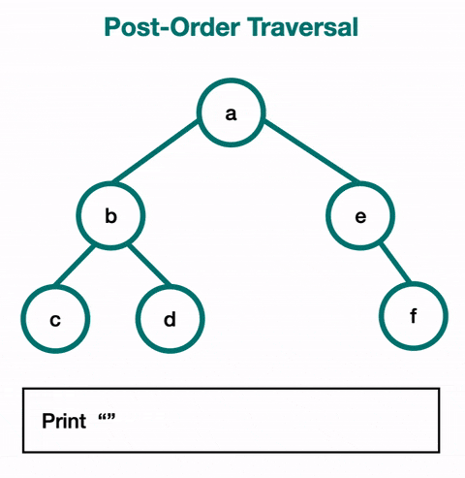
<left><right><root>

Slide 24


Weekcode Challenge #15:
Tree Vocabulary Exercise
Step 1) Draw a Tree with Valid Shape that has at least 11 Nodes
Step 2) Label the Tree using every vocabulary word used on the “Relationships within a Tree” slide

Slide 25

Weekcode Challenge #16:
Tree Properties Exercise
Using your Tree from the previous problem, label the Depth and Height of every Node, then label all Levels of your Tree

Slide 26

Weekcode Challenge #17:
Tree Memory Exercise
Step 1) Populate each Node with random data (doesn’t matter if it technically violates some rules of your Tree type, just give each Node some value, and keep data type consistent for the whole Tree).
Step 2) Organize your Nodes in an indexed array.
Step 3) Organize your Nodes in Pre, In, and Postorder Traversal order

Slide 27

Looking Ahead
Good luck!
Tree Month will persist for all of April
Next week: More Tree stuff

